Slide 1
SMART VEHICLE SECURITY SYSTEM
Guided By :
MRS.LALITHA K
PRESENTED By :
MADHAN.V [22AI025]
SABARISREE.M.Y [22AI043]
HEMANITHRAN.R.S [22AI060]
TEAM NO : 23
22AIP10 & INTERNET OF THINGS LABORATORY

Slide 2
Abstract:
This project develops an IoT-based smart vehicle security system using an ESP32 CAM for wireless video monitoring, GPS for location tracking, and remote control of a solenoid lock, enhancing vehicle security and management.

Slide 3
Objectives:
The objective of this project is to create a smart transportation system that provides real-time vehicle tracking, remote video monitoring, wireless access control, and reliable power management using IoT technology.

Slide 4
Components Required:
ESP32 CAM:
Relay Module:
Solenoid Lock
12V Power Supply/Battery
7805 Voltage Regulator
ByLink App

Slide 5
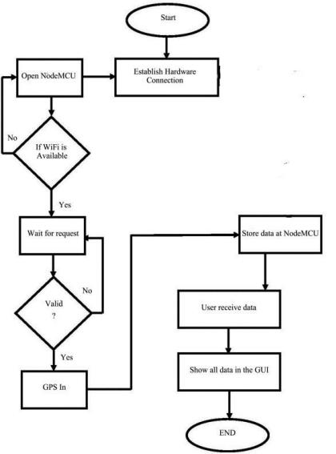
Flow Diagram:

Slide 6
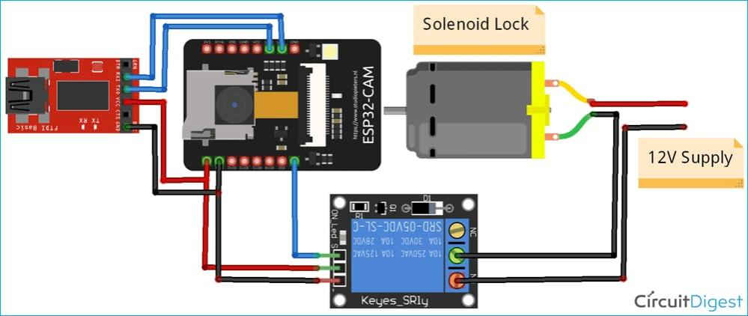
Design:

Slide 7
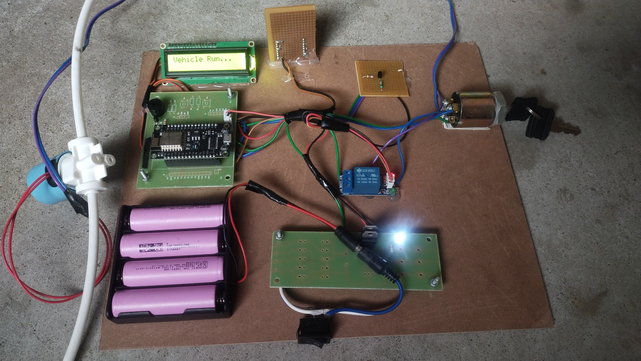
Model:

Slide 8
Implementation:
Hardware:
ESP32 CAM Setup: Connect the ESP32 CAM to Wi-Fi and write firmware to control the camera and relay.
Relay and Solenoid Lock: Connect the relay module to the ESP32 CAM and the solenoid lock to the relay.
Power Management: Use a 12V power supply, regulated to 5V with a 7805 regulator, and stabilize with a 100uF capacitor.
LED Connection: Attach an LED to a GPIO pin on the ESP32 CAM for status display.
System Integration: Combine all components with correct connections and settings.
Testing: Verify that the camera, GPS tracking, relay, solenoid lock, and LED work properly.

Slide 9
Conclusion:
This IoT-based smart transportation system improves vehicle security and management with real-time monitoring and control, offering a reliable and scalable solution for safer transportation operations.

Slide 10
THANK YOU..!!

